Slide 1
Effect Sizes
EDUC 7610
Tyson S. Barrett, PhD
Updated by Carly Fox

Slide 2
What is an Effect Size?
Gives us information about the magnitude and direction of group differences or relationships between variables
Why do we measure it?
Notes:
library(tidyverse)
set.seed(843)
df <- data_frame(
x1 = runif(100),
x2 = rbinom(100, 1, .5),
y = x1 + x2 + 2*x1*x2 + rnorm(100)
)
df %>%
mutate(x2_cat = factor(x2)) %>%
ggplot(aes(x1, y, group = x2_cat, color = x2_cat)) +
geom_point() +
geom_smooth(method = "lm")

Slide 3
Effect Size vs Statistical Significance
Effect Size
Statistical Significance
Meaningfulness of the effect, sometimes in clinical terms
The evidence suggesting whether there is an effect in the population
What it tells us
Does not tell us if an effect exists
Does not tell us if the effect is meaningful or useful
What it doesn’t tell us
Notes:
library(tidyverse)
set.seed(843)
df <- data_frame(
x1 = runif(100),
x2 = rbinom(100, 1, .5),
y = x1 + x2 + 2*x1*x2 + rnorm(100)
)
df %>%
mutate(x2_cat = factor(x2)) %>%
ggplot(aes(x1, y, group = x2_cat, color = x2_cat)) +
geom_point() +
geom_smooth(method = "lm")

Slide 4
Why p-values alone won’t cut it
Relationship between sample size, power, and p-values
To reiterate, p-values are not a measure of the strength between variables
For example, a p < .001 does not mean the treatment is MUCH better than the control condition
It means it is very unlikely that the results we observed would occur if the null hypothesis (e.g., the treatment and control have the same impact) is true
If we want to know the magnitude of the effect of treatment, we need to calculate the effect size

Slide 5
Two Main Classes of Effect Sizes
Standardized effect sizes → describes the size of the effect and removes units of the variables (think standardized coefficients)
Simple (raw) effect size → describes the size of the effect but maintains original units
For example, if you were examining the relationship between study time (in hours) and test score (in points)…
If standardized, you might conclude that for each one unit increase in study time, there is a 2 SD increase in test score (here we remove the original units hrs and points)
If simple (raw), you might conclude that for each one hour increase in study time, there is 5-point increase in test score

Slide 6
Pros & Cons of Standardized vs Simple
Standardized ES for interpreting magnitude of effect when units are not intuitive (e.g. anxiety scale)
Standardized ES for comparison across variables and studies
Need to be careful when using standardized ES for sample size calculation (for power analyses)
Simple good for when distribution is non-normal or when measured in familiar scale (e.g. hours)
Do not standardize categorical variables!

Slide 7
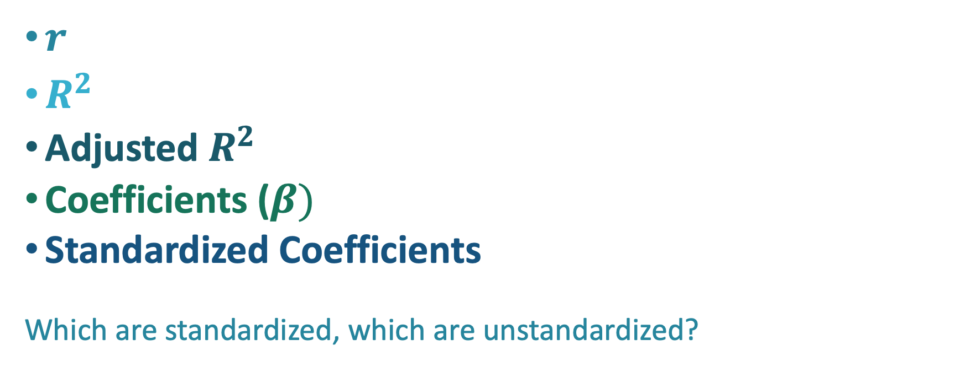
Here are some measures of effect size we already know…
$r$
$R^{2}$
Adjusted $R^{2}$
Coefficients ($β)$
Standardized Coefficients
Which are standardized, which are unstandardized?

Slide 8
But there are many different kinds
Let’s prove it, using a dataset from your new favorite binge-watch show,
Married at First Sight…
You run a simple regression predicting relationship length (outcome) based on the “love expert” couples worked with on the show (dichotomous categorical predictor)
First we run the regression, standardizing the outcome var, we get:
Coefficients Estimate Std. Error t value Pr(>|t|)
(Intercept) -0.113 0.189 -0.594 0.554
Expert_Pepper 0.191 0.247 0.775 0.441
Cohen’s d (Standardized Mean Difference Effect Size)
Can be obtained in simple regression when you standardize the outcome and have a two-level categorical variable
When covariates in model, becomes an adjusted Cohen’s d or an adjusted Standardized Mean Difference Effect Size (STMDES)
Now let’s run a cohens_d( ) function on the same regression, we get:
Cohens_d
0.19
Notes:
library(tidyverse)
set.seed(843)
df <- data_frame(
x1 = runif(100),
x2 = rbinom(100, 1, .5),
y = x1 + x2 + 2*x1*x2 + rnorm(100)
)
df %>%
mutate(x2_cat = factor(x2)) %>%
ggplot(aes(x1, y, group = x2_cat, color = x2_cat)) +
geom_point() +
geom_smooth(method = "lm")

Slide 9
But there are many different kinds
Cohen’s d (Standardized Mean Difference Effect Size)
Can be obtained in simple regression when you standardize the outcome and have a two-level categorical variable
When covariates in model, becomes an adjusted Cohen’s d or an adjusted Standardized Mean Difference Effect Size (STMDES)
Eta-squared
Essentially R²
Odds Ratio
we’ll learn more about this in logistic regression
Notes:
library(tidyverse)
set.seed(843)
df <- data_frame(
x1 = runif(100),
x2 = rbinom(100, 1, .5),
y = x1 + x2 + 2*x1*x2 + rnorm(100)
)
df %>%
mutate(x2_cat = factor(x2)) %>%
ggplot(aes(x1, y, group = x2_cat, color = x2_cat)) +
geom_point() +
geom_smooth(method = "lm")

Slide 10
But there are many different kinds
Cohen’s d (Standardized Mean Difference Effect Size)
Can be obtained in simple regression when you standardize the outcome and have a two-level categorical variable
When covariates in model, becomes an adjusted Cohen’s d or an adjusted Standardized Mean Difference Effect Size (STMDES)
Eta-squared
Essentially R²
Odds Ratio
we’ll learn more about this in logistic regression
Core Idea
Effect size is anything that measures the size of a relationship between variables or a difference between groups
Notes:
library(tidyverse)
set.seed(843)
df <- data_frame(
x1 = runif(100),
x2 = rbinom(100, 1, .5),
y = x1 + x2 + 2*x1*x2 + rnorm(100)
)
df %>%
mutate(x2_cat = factor(x2)) %>%
ggplot(aes(x1, y, group = x2_cat, color = x2_cat)) +
geom_point() +
geom_smooth(method = "lm")

Slide 11
Determining which Effect Size Statistic to Use
Different effect size measures are better suited for different situations…
Categorical variables
Unbalanced group sizes
Lots of variables
Ordinal data (likert scales)

Slide 12
General Interpretations of Effect Sizes
Cohen (and other statisticians) have made recommended effect size interpretations in the past
But these are pretty arbitrary
They can vary based on a number of parameters; highly dependent on field of study
Gain an understanding of what is considered standard in your literature for a small vs large effect size

Slide 13
Valid Interpretation Also Relies on Some Assumptions
Assumptions of regression (do you remember them?)
Reliable measurement of variables (remember our discussion about measure error?)
Generalizable sample/methods/design

Slide 14
Let’s Try an Example…
Going back to the Married at First Sight data set…
You decide that you want to know whether couples who have more satisfying relationships (numerical predictor), tend to earn more money (outcome); you also want to control for their location (categorical predictor).
You start off running a (unstandardized) multiple regression…
Notes:
I think this would be perfect for the in-class activity. For the slides, let’s do a multiple regression that we can show both unstandardized and standardized effect sizes for both continuous and categorical variables.
One with both continuous and categorical → one unstandardized and one with all but categorical standardized with intrepretations

Slide 15
You run the regression in R and get…
lm(Income ~ Satisfaction + Location, data = Mafs)
Coefficients: Estimate Std. Error t value Pr(>|t|)
(Intercept) -0.065 9.940 -0.007 0.995
Satisfaction 9.698 0.772 12.557 <2e-16***
LocationDallas 5.804 8.938 0.649 0.518
LocationNYC 22.692 10.152 2.235 0.029*
Interpreted as…
For each one unit increase in relationship satisfaction, there is an
associated $9,698 increase in couples’ combined income, controlling for
location.
On average, couples living in Dallas earn $5,800 more than couples living in
Atlanta, controlling for relationship satisfaction.
On average, couples living in NYC earn $22,692 more than couples living in
Atlanta, controlling for relationship satisfaction.

Slide 16
But what does a 1 unit increase in “relationship satisfaction” mean?
To increase your interpretability, you decide to standardize your numerical variables (remember, we can’t standardize a category) and get the following…
lm(z_Income ~ z_Satis + Location, data = Mafs) %>% summary( )
Coefficient: Estimate Std. Error t value Pr(>|t|)
(Intercept) -0.140 0.101 -1.384 0.171
z_satis 0.812 0.065 12.557 <2e-16***
LocationDallas 0.090 0.138 0.649 0.518
LocationNYC 0.351 0.157 2.235 0.029*
Interpreted as…
For each 1 SD increase in relationship satisfaction, there is an associated
0.812 SD increase in combined income, controlling for location.
On average, couples living in Dallas have a combined income that is 0.090 SD
higher than couples living in Atlanta, controlling for satisfaction.
On average, couples living in NYC have a combined income that is 0.351 SD
higher than couples living in Atlanta, controlling for satisfaction.

Slide 17
Read More Here!
A Comparison of Effect Size Statistics:
https://www.theanalysisfactor.com/effect-size/
Standardized vs Unstandardized Effect Size Statistics:
https://www.theanalysisfactor.com/two-types-effect-size-statistic/
An in-depth explanation of Effect Size, with Interpretation:
https://www.leeds.ac.uk/educol/documents/00002182.htm

